Slide 1
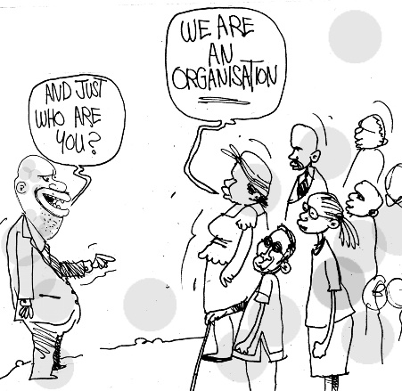
Organisational governance
in
the
non-profit
Sector
www.zgf.org.zm
www.say-zambia.org

Slide 2
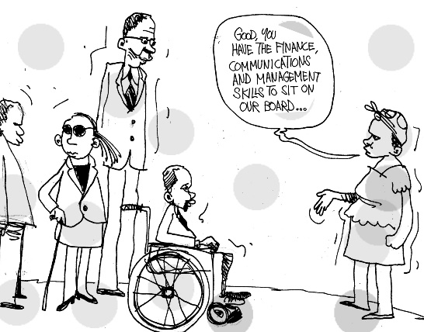
What
makes a
Board
successful?

Slide 3
A successful board
Driven by money
Intrinsic motivation
Prepared and informed
Micro-management
Involvement at policy level
Completely detached
Mostly/only men
Gender balance
Mostly/only women
Dictatorial towards management
Democratic decision-making
Rubberstamp
Confrontational and hostile,
or no debate at all
Healthy debate, accommodating
different views
Operational thinking
Strategic thinking

Slide 4
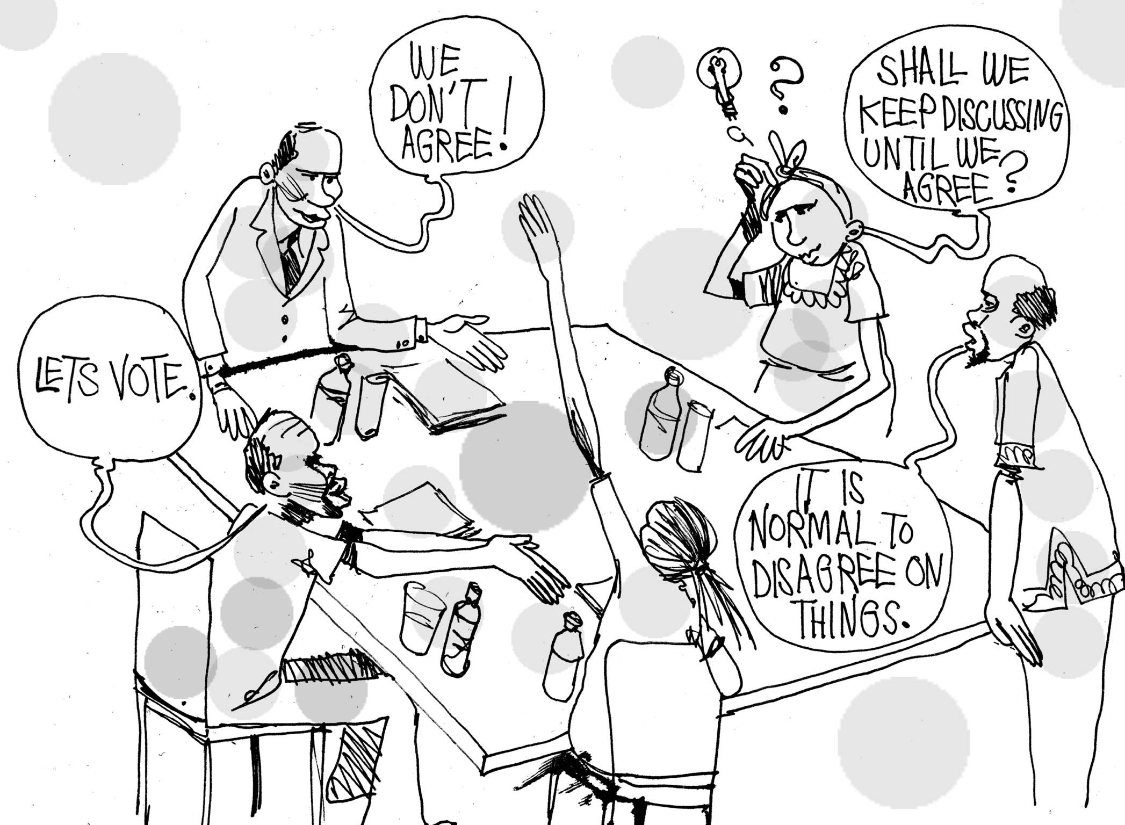
Healthy
debate
Accommodating
different
views

Slide 5
+

Slide 6
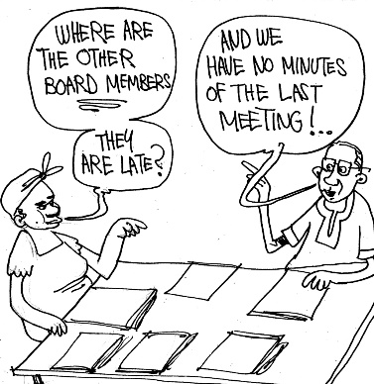
What
are the
common
challenges?

Slide 7
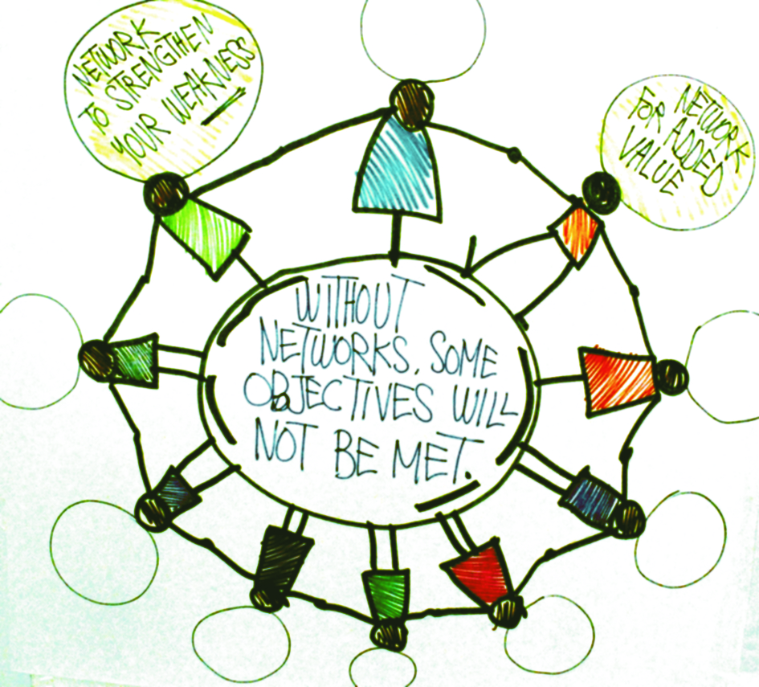
What
is
expected
of a board
in a
rapidly
changing
environment?

Slide 8
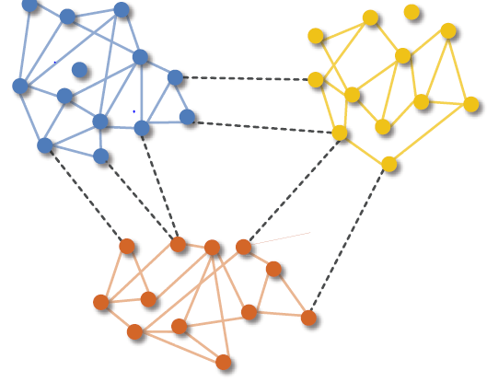
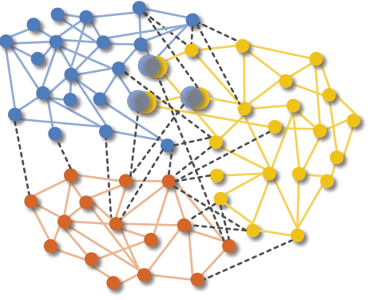
A changing environment…..
Civil society
Civil society
Civil society
Civil society
Civil society
Civil society
Old paradigm
New paradigm
Source: WEF, 2013

Slide 9
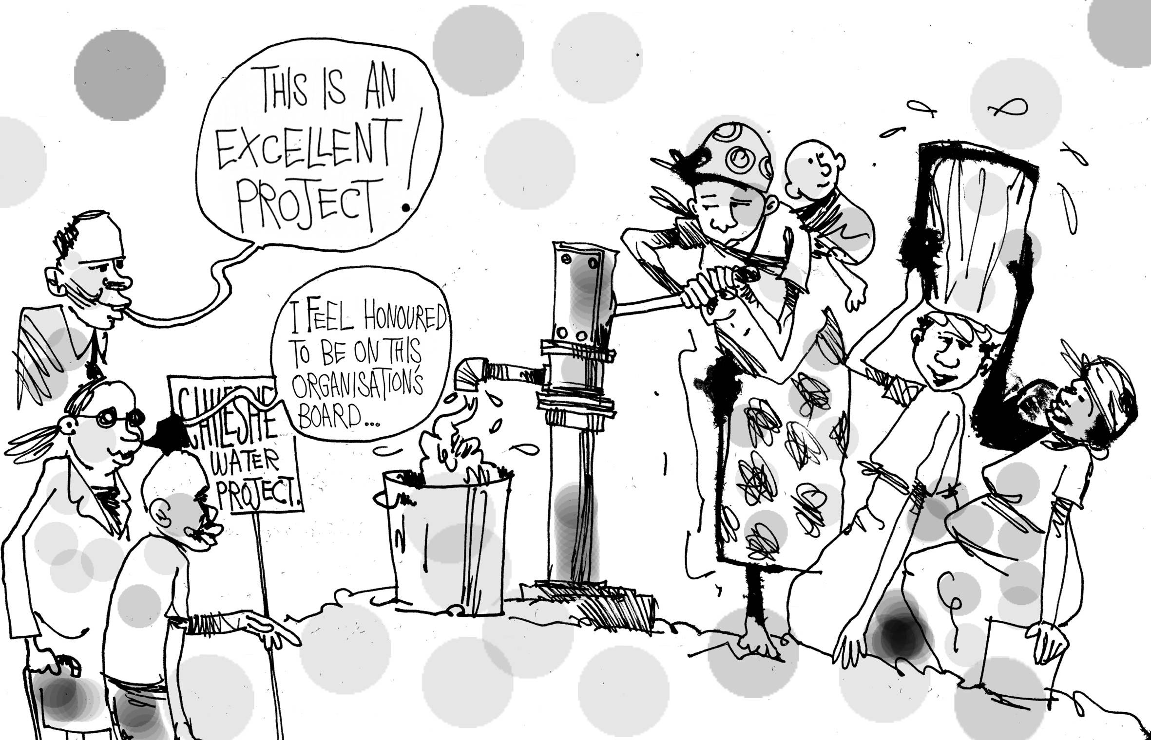
How do we remain relevant?
How do we achieve
financial sustainability?

