Slide 1



2015 British Chamber of Commerce Event on Regional Trade
ZAMBIA : Africa’s New Economic Frontier
Zambia Development Agency

Slide 2





Presentation Outline
ZDA – An overview, Core Divisions
Zambia’s Regional Trade Policy
Key Interventions for Export Development
Zambia’s Trade Performance
Constraints Affecting NTEs Growth
Under Utilization of Production Capacity
Potential for Export Growth

Slide 3
Establishment
Established by an Act of Parliament, ZDA Act No 11 of 2006
Purpose
Key Functions
ZPA,
SEDB,
EBZ,
ZIC, and
ZEPZA
Facilitate access to international Export Markets
Provide Information and Advisory Services to stakeholders
Contribute to the Growth and Competitiveness of local private sector businesses
Facilitate Trade and Investment
To foster economic growth and national development by promoting trade and investment in Zambia through an efficient, effective and coordinated private sector led economic strategy …”
Commenced operations in 2007 after the merger of five quasi-government institutions, namely
ZDA – An Overview

Slide 4

An Overview…….
VISION
To be a world-class Agency in the promotion and facilitation of trade and investment for economic development.
Mission
To effectively and efficiently promote and facilitate investment, trade and competitiveness of businesses operating in Zambia.
Goal
To contribute to the creation of wealth and one million jobs by 2015 through investment and trade promotion, and facilitation.

Slide 5
Core Divisions
Investments Promotion
Export Development
Public Private Partnership and Privatisation
Enterprise Development

Slide 6
Functions of Exports Development Division
Sector Development
Product Development
Sector development strategies
Sector policy advocacy
Export Promotion
Trade fairs and exhibitions
Market Development
Capacity building and training of exporters
Export Financing through Zambia Export Development Fund
Support and liaison with
producer associations
Trade Missions
Buyers Sellers Meetings
Product Development
Other Support
Trade Policy Advocacy
Trade Negotiations
Linkages to Importers
Business and Trade/ Market Intelligence

Slide 7
Zambia's Regional Trade Policy
Zambia has since 1991 pursued a liberal economic and trade policy
Has membership to the World Trade Organisation (WTO), Southern Africa Development Community (SADC), and the Common Market for Eastern and Southern Africa (COMESA).
Other GSP Schemes to Zambia’s benefit include AGOA; EPAS; EBA
It is one of the most open economies in the world
Its trade openness index stood at 82 % in 2014 (World Bank)
And was 76 % in 2013 (World Bank Database 2014)

Slide 8
Key Interventions For Export Development
  Fairs & Exhibitions
    Africa Big Seven
    All Africa Leather Fair
    Democratic Republic of Congo Trade Mission and Solo Exhibition
    Botswana Global Expo
    Zambia International Trade Fair, Zambia Agriculture and Commercial Show
  Market Research (Mozambique, Botswana, Namibia, Burundi, Rwanda )
  Product Value chain development (Honey)
  Trade Logistics Study in Nakonde and Chirundu
  Explored border processes and challenges faced by exporters
  Trade Negotiations
  SADC Trade in Services
  Tripartite Trade Negotiations
  COMESA Summit, Exhibitions and Negotiations

Slide 9
Zambia's Trade Performance
NTEs Trends 2010 to 2014

Slide 10
Export Earnings by Market Regions- US$ Millions, 2010-2014
Source: CSO Statistics

Slide 11
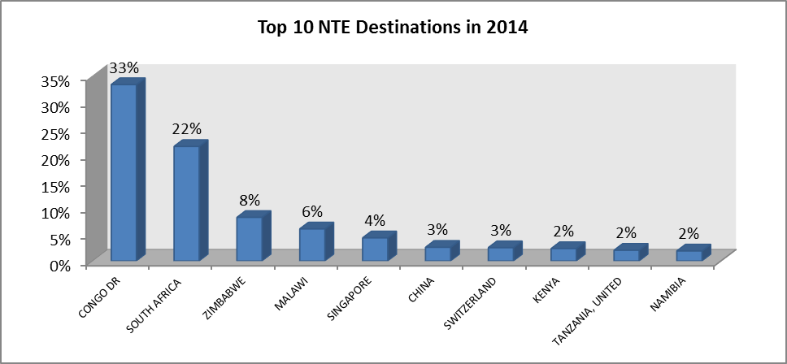
NTE Earnings From Top 10 Countries in 2014

Slide 12
Value of Top Markets from the Region in 2014 (US$ Millions)
  DR Congo – 802.57
  South Africa – 521.23
  Zimbabwe – 198.38
  Malawi – 145.89

Slide 13
Top NTE Products in 2014

Slide 14
Key Constraints Affecting NTEs Growth
Under-Utilization of Production Capacity-Factors
Notes:
Other constraints are: NTBs such as prolonged stringent and complicated rules, quality standards, packaging and labelling standards,

Slide 15
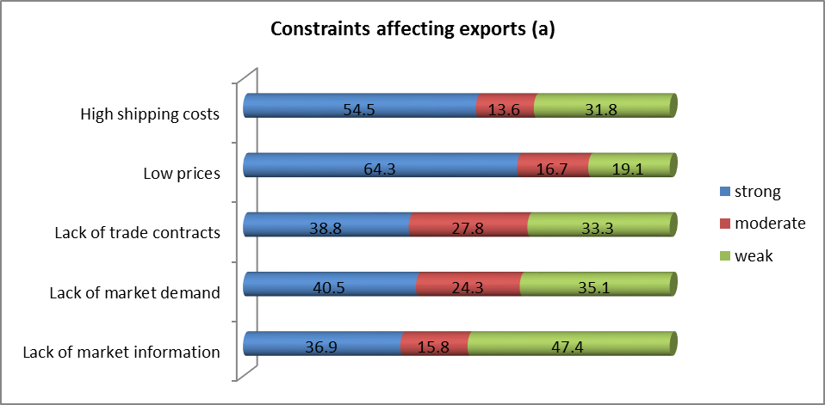
Key Constraints Affecting NTEs Growth, Contd

Slide 16
Under-Utilization of Production Capacity-Factors

Slide 17
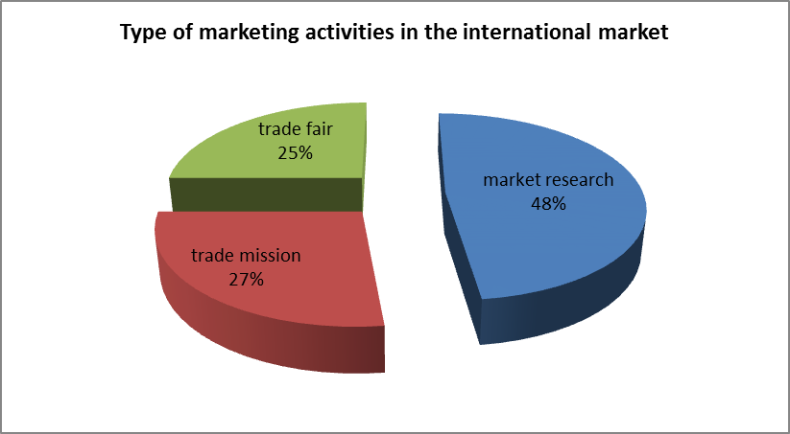
Preferred type of International activities
Preferred type of international actvities

Slide 18
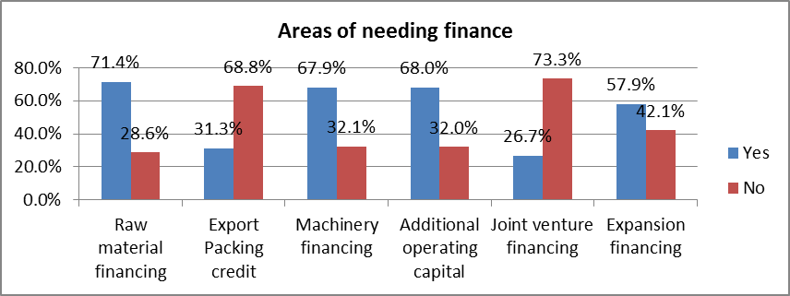
Finance Requirements.
  Export Finance
  Technical regulations and quality standards
  Lower internonal prices for agricultural commodities
  High cost and volatility of foreign exchange
  High cost of production
  High cost of borrowing from commercial banks
  Other Tariff and Non –Tariff Barriers
Notes:
Areas needing finance to improve production capacities in meeting export targets

Slide 19
Other Constraints Affecting NTEs Growth
  Export Finance
  Technical regulations and quality standards
  Lower international prices for agricultural commodities
  High cost and volatility of foreign exchange
  High cost of production
  High cost of borrowing from commercial banks
  Other Tariff and Non –Tariff Barriers

Slide 20


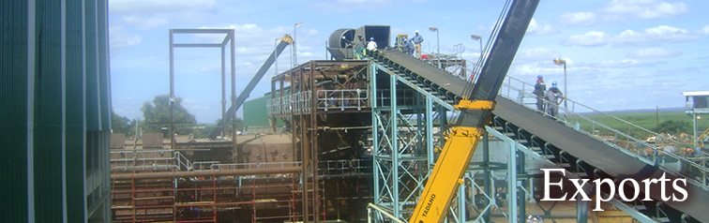

A-to-Z information on the Zambian market
Guidance through the entire export and investment process and aftercare
Provision of matching Zambia partners and building contact networks
Global export market information & product development
SME & business development services
Zambia Development Agency
Privatisation House, Nasser RD
P.O. Box 30819, LUSAKA. ZAMBIA
Tel: +260 211 220177
Fax: +260 211 225270
Website: www.zda.org.zm
Email: info@zda.org.zm

