Slide 1
British Chamber of Commerce Entrepreneurship Event Bayo Akindeinde PEPZ Team Leader
Private Enterprise Programme Zambia
Thursday 26th 2016

Slide 2
DFID-Z rationale for support via PEPZ
Current downturn, highlights need to diversify away from focus on mining sector support to other sectors of the economy
Growth has been driven by FDI. Also Zambia’s private sector is weak and dualistic. Therefore, building a competitive private sector requires supporting a spectrum of businesses – from start-up to anchor companies
Economy not creating sufficient jobs – so need to stimulate SME job creation
Delivering necessary support to assist an economy facing market development challenges

Slide 3
What is PEPZ intended to achieve?
Impact
A private sector capable of delivering inclusive growth (i.e. small businesses, women, youth)
Outcome
MSMEs with increased size and capability.
Stimulating entrepreneurship & supporting job creation
Outputs
Growth in targeted SMEs – access to Finance & Technical Support
More small businesses supplying larger firms
Increased demand for consulting & expert support
Improved attitudes to entrepreneurship

Slide 4
About Private Enterprise Programme Zambia
PEPZ is a 5-year project funded by DFID
Implemented by Nathan Associates London
13 Full-time staff
Organised into 4 components:
Business Linkages Programme
Business Development Services
Business Plan Competition
Accelerator Fund (Managed by Kukula Seed Fund)

Slide 5
Business Development Services
What exactly is BDS?
Business support and advisory services – including consulting, training, mentoring and implementing systems
PEPZ wants providers of BDS to be:
Innovative with sustainable delivery models for BDS
Replicate tried & tested services to newer, wider markets
Present small business support proposals to that can be grant funded

Slide 6
Year 1 Nyamuka Zambia BPC
Advertising campaign to launch Nyamuka Zambia brand
30 Business clinics; 6 Business Essentials Workshops
554 Applications; 60 semi-finalists; 20 winners
25% women applicants
60% women in top five
60% start ups & 40% Existing Business
12 New Businesses Registered
Notes:
Nyamuka Zambia was established as a recognisable brand generating interest within the key catchment areas of Lusaka & Copperbelt – However, also got coverage outside of these key catchment areas interest came in from all over Zambia.
Nyamuka Zambia gained significant media through mainstream media outlets such as newspapers, radio and television.
In addition Nyamuka developed a significant social media presence through Facebook and Twitter. Facebook alone has over 10,500 likes while twitter has over 500 followers. Significant levels of engagement particularly in phase one were recorded

Slide 7
The Game Plan TV show
The Game Plan TV Show Judges & Moderator

Slide 8
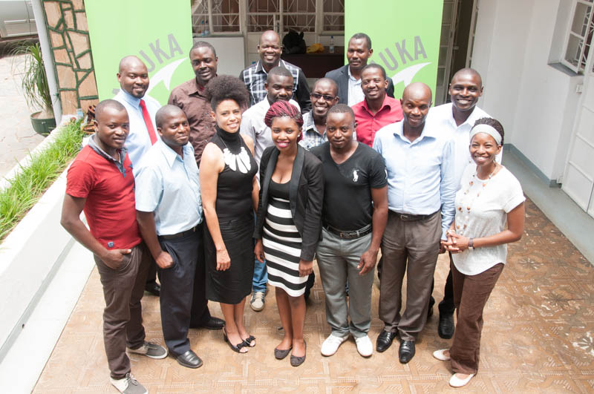
Nyamuka Zambia 2015 winners
2015 Nyamuka Zambia winners at Business Breakfast

Slide 9
PEPZ Business Linkages Programme
Vision
Corporates in Zambia are actively seeking and transacting with locally based SME suppliers that are internationally competitive with support from dynamic business linkage platforms
Purpose
To foster systemic change & real outcomes by changing the mind-set of corporations and suppliers, and the way of doing business
Committed corporate partners leading the agenda of the SC, and guiding the programme through its journey to local procurement
At least 50 SMEs with increased transactions with corporates
Zamb2b fully operational & generating transactions between buyers and suppliers
Outcomes

Slide 10
Our Steering Committee partners
Shoprite
SABMiller
Spar
Chibuluma Mines
Zambeef
Saro Agro
CFAO
Woolworths
TOTAL
First Quantum Minerals

Slide 11
How do we help small businesses? Our Step-by-step approach
Identify supplier criteria from the buyer of the larger companies – “the Anchor firms”
Conduct a diagnostic assessment of your business – identifying your strengths & weaknesses and areas for further improvements
Compile a Management Improvement Plan to address the requirements of the anchor firm
Consider a grant towards the cost of implementing the improvement plan
Liaisons with the anchor firm intended to increase the number of transactions with the small business supplier i.e. increase in sales

Slide 12
Examples of areas of grant support
Business plan - to raise finance or as a directional tool
Warehousing & distribution logistics
Financial management information systems
Improve your productivity and product quality
Developing a marketing strategy & sales plan
Create a strong marketing strategy and plan;
Implementing quality management systems and accreditation e.g. ISO900, HACCP, etc.
Identifying business processes that can be improved via IT

Slide 13
Criteria for working with PEPZ
Be a registered entity, doing business for profit;
Have been legally operating for more than 1 year;
Be majority-owned by Zambian citizens;
Employ more than 5 people full-time;
Supply a product or a service that is competitive and of value to corporations;
Be willing to benefit from matchmaking with corporations;
Be willing to be assessed to identify areas for improvement;
Demonstrate a commitment to increasing opportunities for women;
Demonstrate a desire to work in ways that are sensitive to the environment.

Slide 14
www.zamb2b.com
Problem
A portal designed to address Market Information Failure
Local suppliers not easy to find
Opportunities & qualification criteria from buyers not transparent
Solution
An electronic “market place” that includes:
A data base of suppliers,
A platform to broadcast opportunities & tenders from buyers
Dissemination of business news on policy development, market trends, events, etc.
Business info flows 2 ways
Expected outcomes
Economic growth
Mutual understanding & improved ground for transactions
Jobs created
Increased transactions between registered suppliers &buyers

Slide 15
Contact Details
Interested in linkages?
Email: blp@pepzambia.com;
or Call: +260 211 259 974
For further PEPZ Information:
Bayo Akindeinde; Team Leader PEPZ
bayo@pepzambia.com

