Slide 1
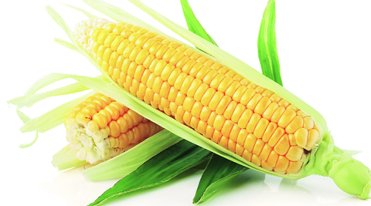
ECONOMIC DIVERSIFICATION THROUGH ZAMBIA’S AGRICULTURE
Jacob Mwale
CEO
ZAMACE Limited

Slide 2
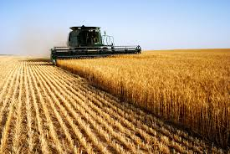
Submission: Embrace Agribusiness
Long term view of agriculture, supported by medium & short term serious investments
Our vision as private sector agribusiness is to have a predictable policy environment
Be aggressive in implementing drivers of growth in agriculture

Slide 3
What is Required for Economic Diversification Through Agriculture?
The Zambian government spends up to 98% of its Poverty Reduction Program Budget on maize and fertilizer subsidies (Source MAL, IAPRI)
This stifles agricultural diversification

Slide 4
What is Required for Economic Diversification Through Agriculture?
Stable economic environment
Predictable policies
low and stable inflation
Stable exchange rates

Slide 5
Predictable Policies
Medium to long term commitments
Agriculture policy in practice is reviewed annually discouraging investment
SMART management of maize – value chain
Maize is an economic commodity that should be resolved by the market
Welfare strategies should be used to help the vulnerable because subsidies do not work
Actual commitments not just plans : Unbundle plans such as NAIP (Livestock, Legumes, Horticulture, Fisheries)

Slide 6
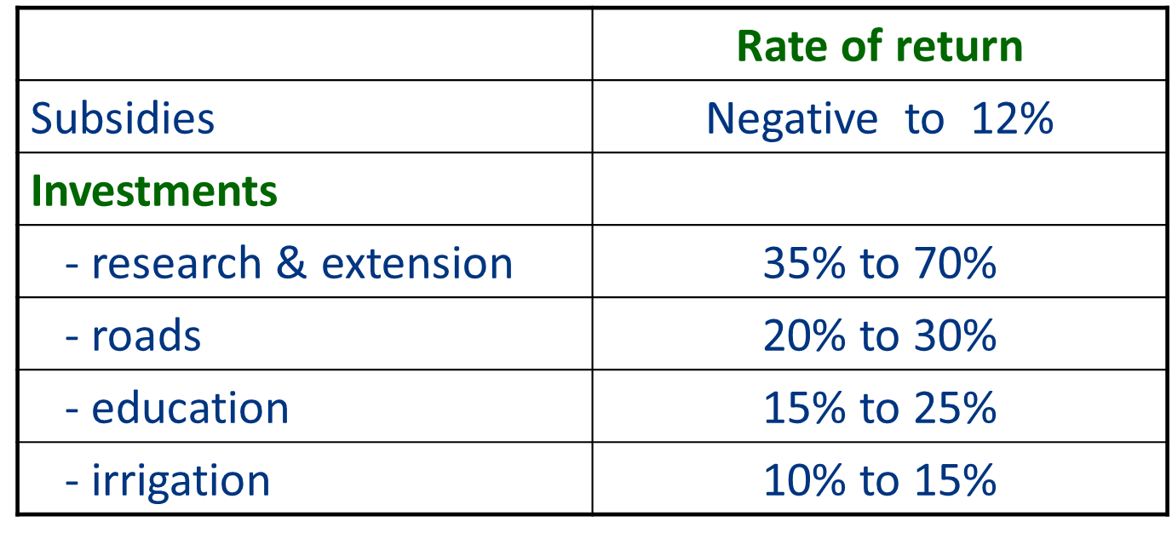
What is Required for Economic Diversification Through Agriculture?
In public expenditure government must begin to invest in the things that help productivity and business thrive (IFPRI)

Slide 7
The Challenge of Economic Diversification
Agriculture employs 52.2% (2,872,331) of the total labour force compared to 1.6% (88,251) employed by the mines (CSO 2012 labor force survey)

Slide 8
The Challenge of Economic Diversification
GRZ reports that mines earn from 60 to 95% of foreign exchange
Import heavy economy like Zambia the mines will be important
Mines are visible and easier to tax
Yet, if productivity gains do not occur in agriculture, the biggest employer, poverty will not go down (evidence from Asia, China and Europe)

Slide 9
Conclusion
Agribusiness can provide the employment, the tax and the foreign exchange that can be the much needed economic diversification route
For that to happen we (the country) need
to invest in the drivers of agricultural growth
to have a long term view of agribusiness
To have a stable macro environment

Slide 10
Thank you!!!!

