Slide 1
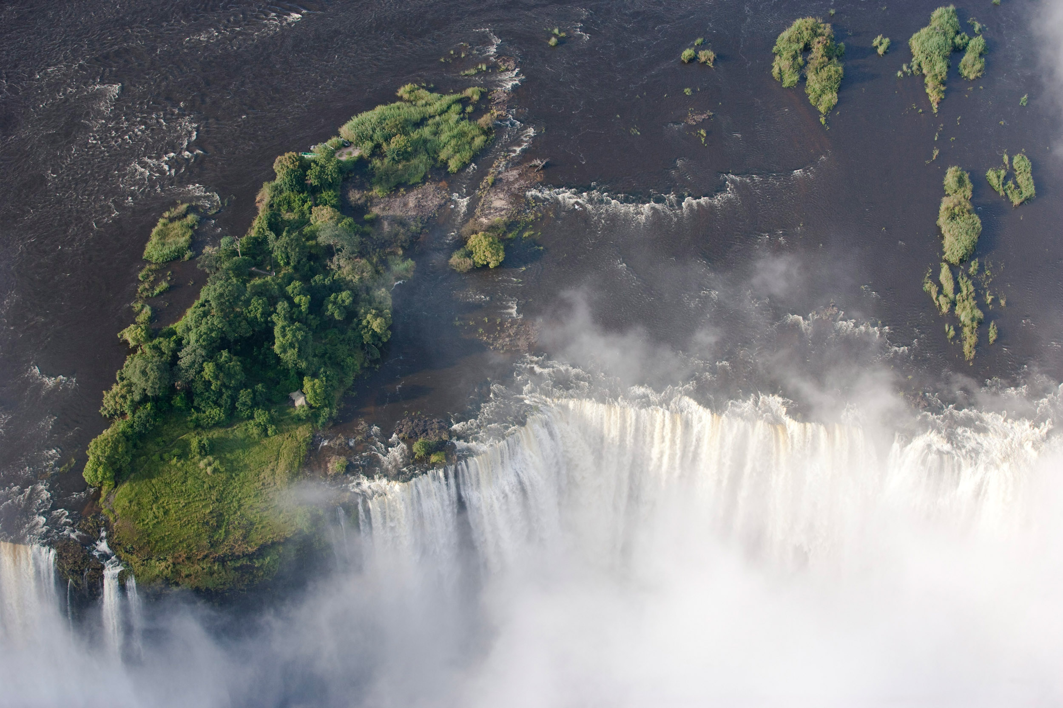
ZAMBIA TOURISM BOARD
THE TOURISM INDUSTRY IN ZAMBIA
A PRESENTATION AT THE GUEST LECTURE BY PROFESSOR HUANG SOON FOOK, BINARY UNIVERSITY, MALAYSIA ON POLICY OPTIONS FOR TOURISM DEVELOPMENT AND PROMOTION IN ZAMBIA.
Presented by: Felix S. Chaila
MANAGING DIRECTOR
Tuesday 4th August, 2015
BEST WESTERN PLUS LUSAKA GRAND HOTEL

Slide 2
Tourism potential in pictures!
Vic Falls – 500,000 tourists/year
Niagara Falls – 30m tourists/year

Slide 3
Tourism potential in pictures!
Empty Samfya beach
Beach in Thailand

Slide 4
PRESENTATION OUTLINE
Overview of current situation
Issues and challenges
Illustration of selected challenges
SWOT Analysis
Way forward / Strategic focus

Slide 5
1. OVERVIEW OF CURRENT STATUS
Zambia Tourism Board (ZTB) established by Act No. 24 of 2007.
The Zambia Tourism Board Act No. 24 of 2007 section 4. (1) provides that “It shall be the general duty of the Board to promote such measures as may be necessary to achieve the maximum publicity of Zambia’s tourist attractions, locally and internationally.”

Slide 6
CURRENT STATUS - ARRIVALS
 | 2008 | 2009 | 2010 | 2011 | 2012 | 2013
Arrivals | 811,775 | 709,948 | 815,140 | 920,299 | 859,088 | 914,576
Holiday | 184,366 | 171,949 | 250,686 | 194,215 | 223,342 | 251,824
% of total arrivals | 23% | 24% | 31% | 21% | 26% | 27.5%
2014
946,969
% of total Business Arrivals |  | 259,044 36.4% | 429,844 52.7% | 500,727 54.4% | 465,145 54.14% | 479,892 52.4%

Slide 8
2. ISSUES AND CHALLENGES
Border crossing hurdles
Police road blocks
Yellow fever requirements by South Africa - RESOLVED
EU Black listing of Zambian registered air crafts
Perceived as expensive destination
Border crossing hurdles
Police road blocks
Visa regime – E-visas introduced 14th October 2015 / UNIVISA introduced between Zambia and Zimbabwe last year
Air line connectivity
Low relevant skills and expertise in the industry
Limited marketing budget

Slide 9
3. ILLUSTRATION OF SELECTED CHALLENGES

Slide 10
Issues & challenges - Visa regime
Visa Fees for Selected Southern African Countries “USD”
 | Zambia |  | Botswana |  | Namibia |  | Zimbabwe
 | Single | Multiple | Single | Multiple | Single | Multiple | Single | Multiple
UK and Ireland | 50 | 80 | 0 | 0 | 0 | 0 | 55 | 70
EU | 50 | 80 | 0 | 0 | 0 | 0 | 30 | 45
Canada | 50 | 80 | 0 | 0 | 0 | 0 | 75 | -
USA | 50 | 80 | 0 | 0 | 0 | 0 | 30 | 45
*Source – Zambia Institute for policy analysis & research
There is need for Zambia to carry out urgent and comprehensive review of visa regime.
Namibia and Botswana have eased visa requirements for key source markets.

Slide 11
Issues and challenges – marketing budget
Country | Arrivals | Marketing Budget | Tourism earnings | ROI
South Africa | 11.5m | $180m | $9bn | $50
Zimbabwe | 2.2m | $13m | $634m | $49
Kenya | 1.1m | $150m | $756m | $5
Namibia | 989k | $10m | $438m | $44
Tanzania | 794k | $18m | $1.3bn | $72
Zambia | 815k | $3m | $210m | $70
Namibia | 997k | - | - | -
Botswana | 1.6m | - | - | -
Low marketing spend by Zambia relative to competitors in sub – region may result in destination substitution.
Although Zambia has lowest market spend, ROI is very competitive
World Tourism receipts were almost $1trillion in 2010 – Southern Africa received only 1.7% of this.

Slide 12
Competitive analysis - price
PARAMETER | ZAMBIA | ZIMBABWE
Presidential suite - average | $1155 | $503
Double room - package | $492 | $350
Double room - Hotel | $518 | $275
Cheapest main course | $6 | $13
Most expensive main course | $15 | $22
Water Rafting | $160 | $120
Elephant Rides | $150 | $130
Micro Flights (15 Minutes) | $140 | -
Helicopter flight (15 Minutes) | $145 | $130
Boat Cruise | $60 | $45
*Source – Zambia Institute for policy analysis & Research
Overall, Zambia is more expensive than Zimbabwe on all fronts except for food

Slide 13
4. DESTINATION ZAMBIA SWOT ANALYSIS
Strengths Home of the might Victoria Falls – one of the natural wonders of the World. Diverse product offer – wildlife, cultural tourism, waterfalls, heritage sites, adventure activities. Relatively safe and secure Country Friendly and welcoming people Fresh and unexplored destination | Weaknesses Limited and expensive local and international connectivity. Perceived as expensive destination Unknown destination – limited marketing activity (over dependence on nature based products) Unfavourable visa regime Limited accommodation in key local destinations.
Opportunities Growing demand for long haul travel from Europe. Zambia’s location ideal for multi destination packaging . Abundant opportunities for investment in tourism sector. Safety concerns in traditional tourism hubs – Egypt and Kenya. | Threats Yellow fever certificate for transits through South Africa. Zimbabwe awakening EU aviation ban Recession in key source markets
Key tactics
Resource concentration on marketing in 3 key source markets and 4 emerging markets.
Comprehensive market research on the targeted key source markets.
Significant investment and outsourcing of website and social media communication platfor.
Outsource and Scientific approach to tackle international markets – using research to guide focus.
Social media (Viral)marketing
International media (CNN, BBC, Super sport, National geographic) campaigns – leverage on UNWTO hosting
Informative and well packaged local TV and radio shows
Domestic and international road shows / fairs – trade and consumer
Commission comprehensive research to understand domestic tourism potential.
Factors affecting the plan
Limited marketing budget relative to competitors
Delays in release of allocated marketing spend.
Scanty domestic market research information to guide marketing intervention
Barriers to entry (EU ban, Yellow fever, visa regime, )
Poor infrastructure around some tourism attractions
Perception of expensive destination
Inadequate staff compliment at ZTB

Slide 14
5. WAY FORWARD /STRATEGIC FOCUS
Lobby established brand hotels to invest in Zambia
Website and social media marketing
Outsource website and social media development and management with fresh look and feel and updated content.
Work with ZDA to lobby investment in local aviation industry
Contract experts - CBI to train ZTB and local operators in social media and website marketing optimisation
Joint destination packaging with Zimbabwe and approach international airlines.
Promote direct flights to Livingstone
Joint marketing collaboration with airline servicing Zambia route
Airline connectivity
Attend hotel investment conferences
Work joint plan of action with ZDA
Organise investment forum with end to end linkages.
Encourage existing hotels to expand beyond Lusaka
Establish database of key hotel chains operating in Africa

Slide 15
Way forward / Strategic focus
Segment and niche marketing
Indentify key segments and niche markets for target marketing
Market focus
Adopt focused approach targeting South Africa, UK, USA , India, China, Australia
Communication channels
Identify life style magazine targeting women as decision makers
Contract experts - CBI to train ZTB and local operators in social media and website marketing optimisation
Develop product profile for respective segments and niche markets
Dedicate resources for separate promotional campaigns for defined segments / niche
Identify appropriate platforms for targeting niche / segments with marketing campaigns.
Detailed Market intelligence on each target market
Develop plan of action and calendar of events for each target market.
Outsource website and social media development and management with fresh look and feel and updated content.

Slide 16
Way forward / Strategic focus
Product packaging /Development
Package cultural and heritage products to enhance destination attractiveness
Collaborate with relevant stakeholders to enhance product packaging
Strengthen link between marketing promotion and product Development
Promote domestic tourism

Slide 17
Way Forward
Leverage on the hosting of UNWTO to continue to raise destination profile.

Slide 18
THANK YOU FOR YOUR ATTENTION

